Slide 1
ALY 6070 Communication and Visualization for Data Analytics
Statistical Correlation

Slide 2
Correlation
Statistical technique that can show whether and how strongly pairs of variables are related.
For example, height and weight are related; taller people tend to be heavier than shorter people.
Correlation can tell you just how much of the variation in peoples' weights is related to their heights.
Correlation is not Causation
*source: https://www.surveysystem.com/correlation.html

Slide 3
Correlation Coefficient
The main result of a correlation is called the correlation coefficient (or "r").
It ranges from -1.0 to +1.0.
The closer r is to +1 or -1, the more closely the two variables are related.
*source: https://www.surveysystem.com/correlation.html

Slide 4
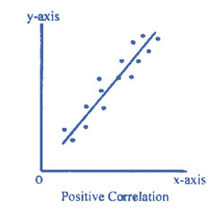
Positive correlation
If r is positive, it means that as one variable gets larger the other gets larger.
R-squared is common in linear regression, explains the variation in Y by X as a positive value
*source: https://www.emathzone.com/tutorials/basic-statistics/positive-and-negative-correlation.html

Slide 5
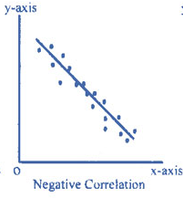
Negative correlation
If r is negative, it means that as one variable gets larger the other gets smaller
Inverse correlation
*source: https://www.emathzone.com/tutorials/basic-statistics/positive-and-negative-correlation.html

Slide 6
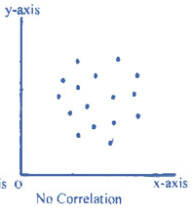
No correlation
If r is close to 0, it means there is no relationship between the variables.
Sometimes “cloud shaped”
*source: https://www.emathzone.com/tutorials/basic-statistics/positive-and-negative-correlation.html

